Slide 1
Internet of Things
(IoT)
By: Yahya Raees

Slide 2

What is IoT?
IoT is a network of physical devices, appliances, and other objects embedded with sensors, software, and connectivity to exchange data over the internet.
IoT Concept : Connecting Internet and Physical Devices

Slide 3
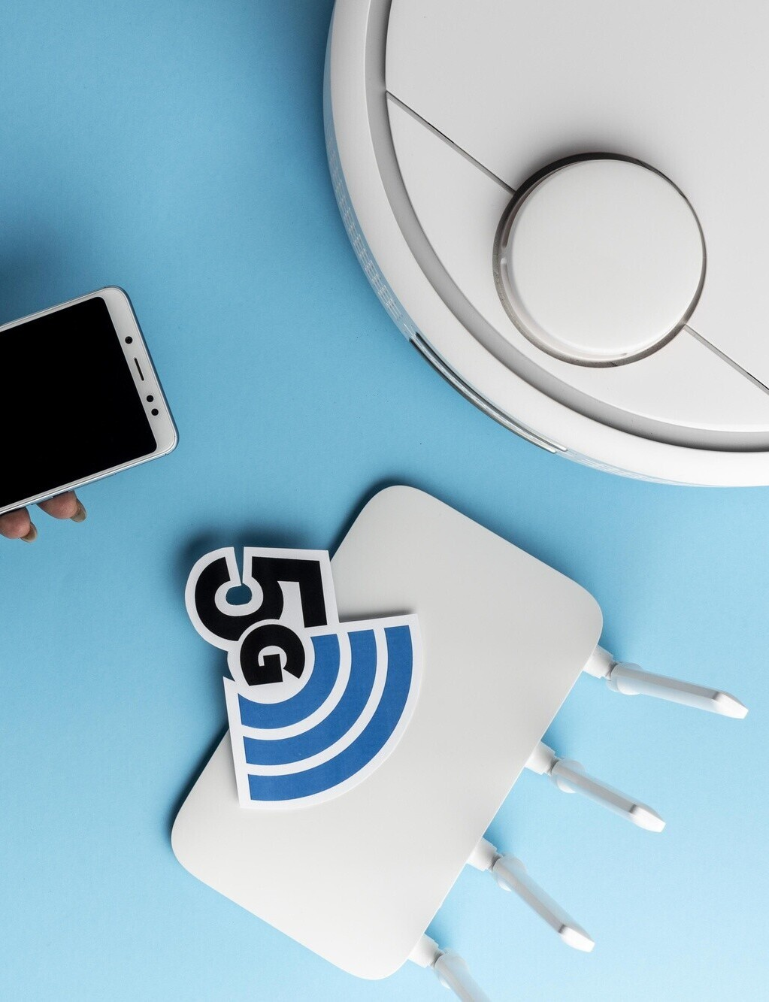
Importance
It automates processes,
Improves efﬁciency and gives value information like that of applying it for home automation, transport, and healthcare.

Slide 4
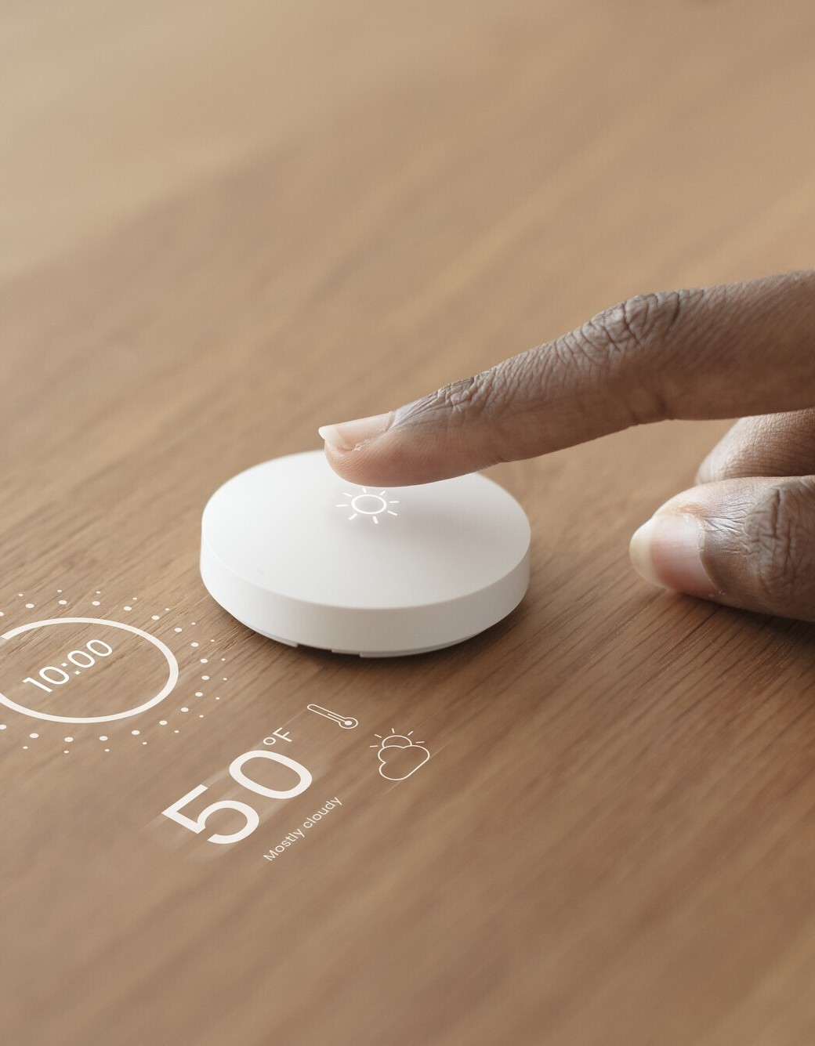
Structure
Sensors :temperature, motion Connectivity: Wi-Fi, Bluetooth, or cellular networks transmit data
Connectivity: Wi-Fi, Bluetooth,
or cellular networks transmit data
User Interface: Users can view
or remotely control devices using apps.

Slide 5
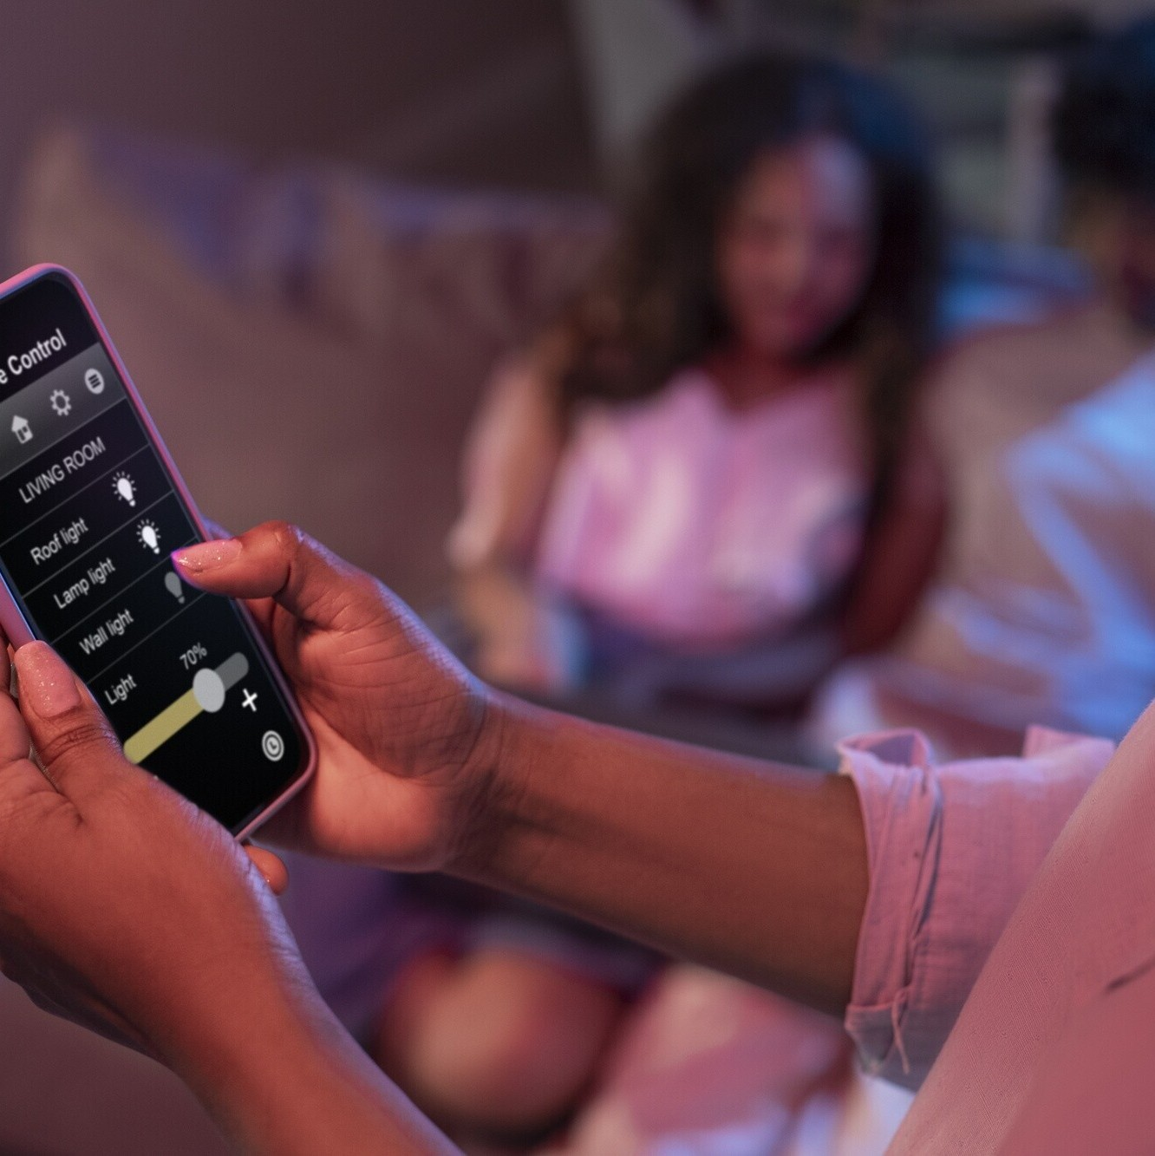
Applications
Smart Homes: voice assistants like Alexa, smart lights,
Healthcare: Wearable devices Intelligent Cities: Smart Street Lights, Waste Bins, and Trafﬁc Management.IndustriesTran sportations etc

Slide 6
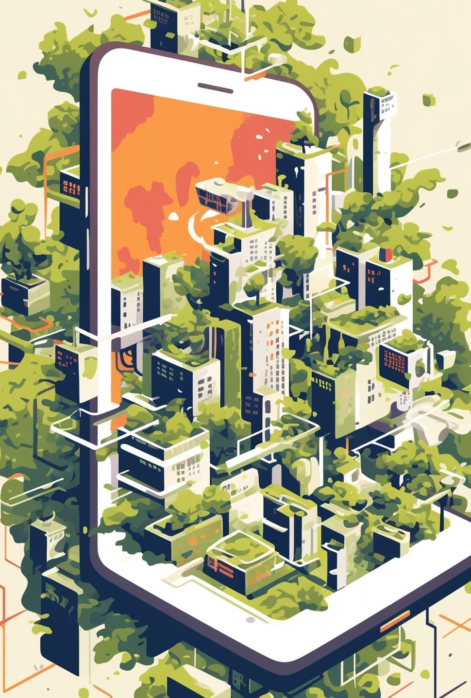


Pros
Convenience: Automates routine functions and saves time.
Efﬁciency: Reduces waste and optimizes resource usage.
Cons: Barriers
Data Privacy High Costs

Slide 7
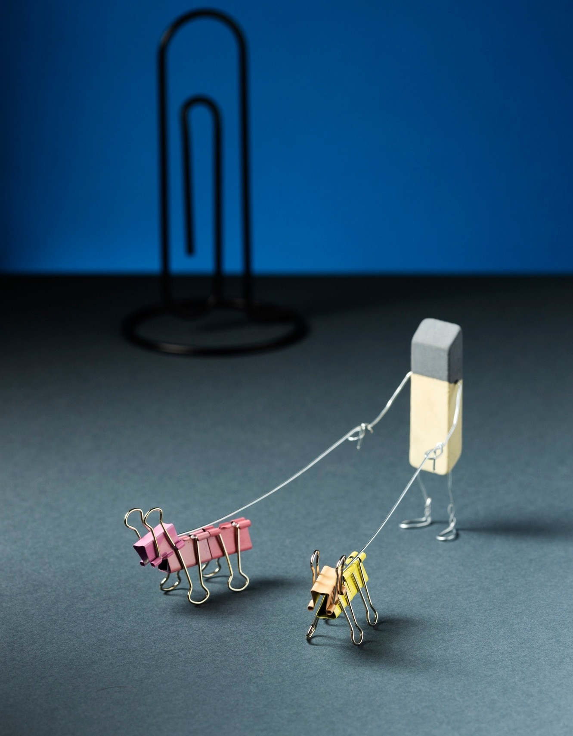
Conclusion
Making such objects connect physically but literally smart in a way that they enabled them to talk, process data or even do tasks alone.

Slide 8
Tha⁵⁰ nks

